Slide 1

Choose Your Adventure: Zombie Apocalypse
Dylen Belanger

Slide 2
Table of Contents
Information about the programmer
Information about the program (Story line, Goal, etc.)
How to play

Slide 3
About the Programmer
Dylen Belanger (2004- ) is an eleventh grade student at St. Joseph’s Catholic High School. He has a twin brother named Harrison Belanger. During Dylen’s spare time, he enjoys to run and work out. Dylen’s favourite subjects in school are Math, Science, and Programming. He has three dogs at home named Rocky, Alley, and Louie.

Slide 4
About the program
You are a resident of Toronto, Ontario. An unfortunate nuclear accident was recently announced on the day June 17, 2051, which commenced the first ever zombie apocalypse in history.
In this program, your job is to prepare for the upcoming zombie apocalypse. You must search for all your family members inside your home, so they can be sent to a safe place, away from the zombies. Beware, you must act quickly. If you are too slow, you will be incapable of rescuing you and your family.
Once all your family members are located, you will be required to head out to stock up on supplies for your family. It is your job to decide what is best to buy. After you gather up your items, you will be sent back to your shelter to care for your family until it is safe to live normally once again. If things go south, you may encounter some zombies on your way back home.
It is your job to avoid the zombies and to protect your family at all costs! Good luck!

Slide 5

How to Play
You will begin the game at your house. Depending on which room you are in, you will be asked a question that is unique to that room. To answer the question, choose the number that corresponds to your choice.
Example: Would you like to 1. Check your parents' bedroom 2. Check your brother's bedroom 3. Walk down the hall towards the main part of the house
If you chose to walk down the hall, you would input “3”

Slide 6
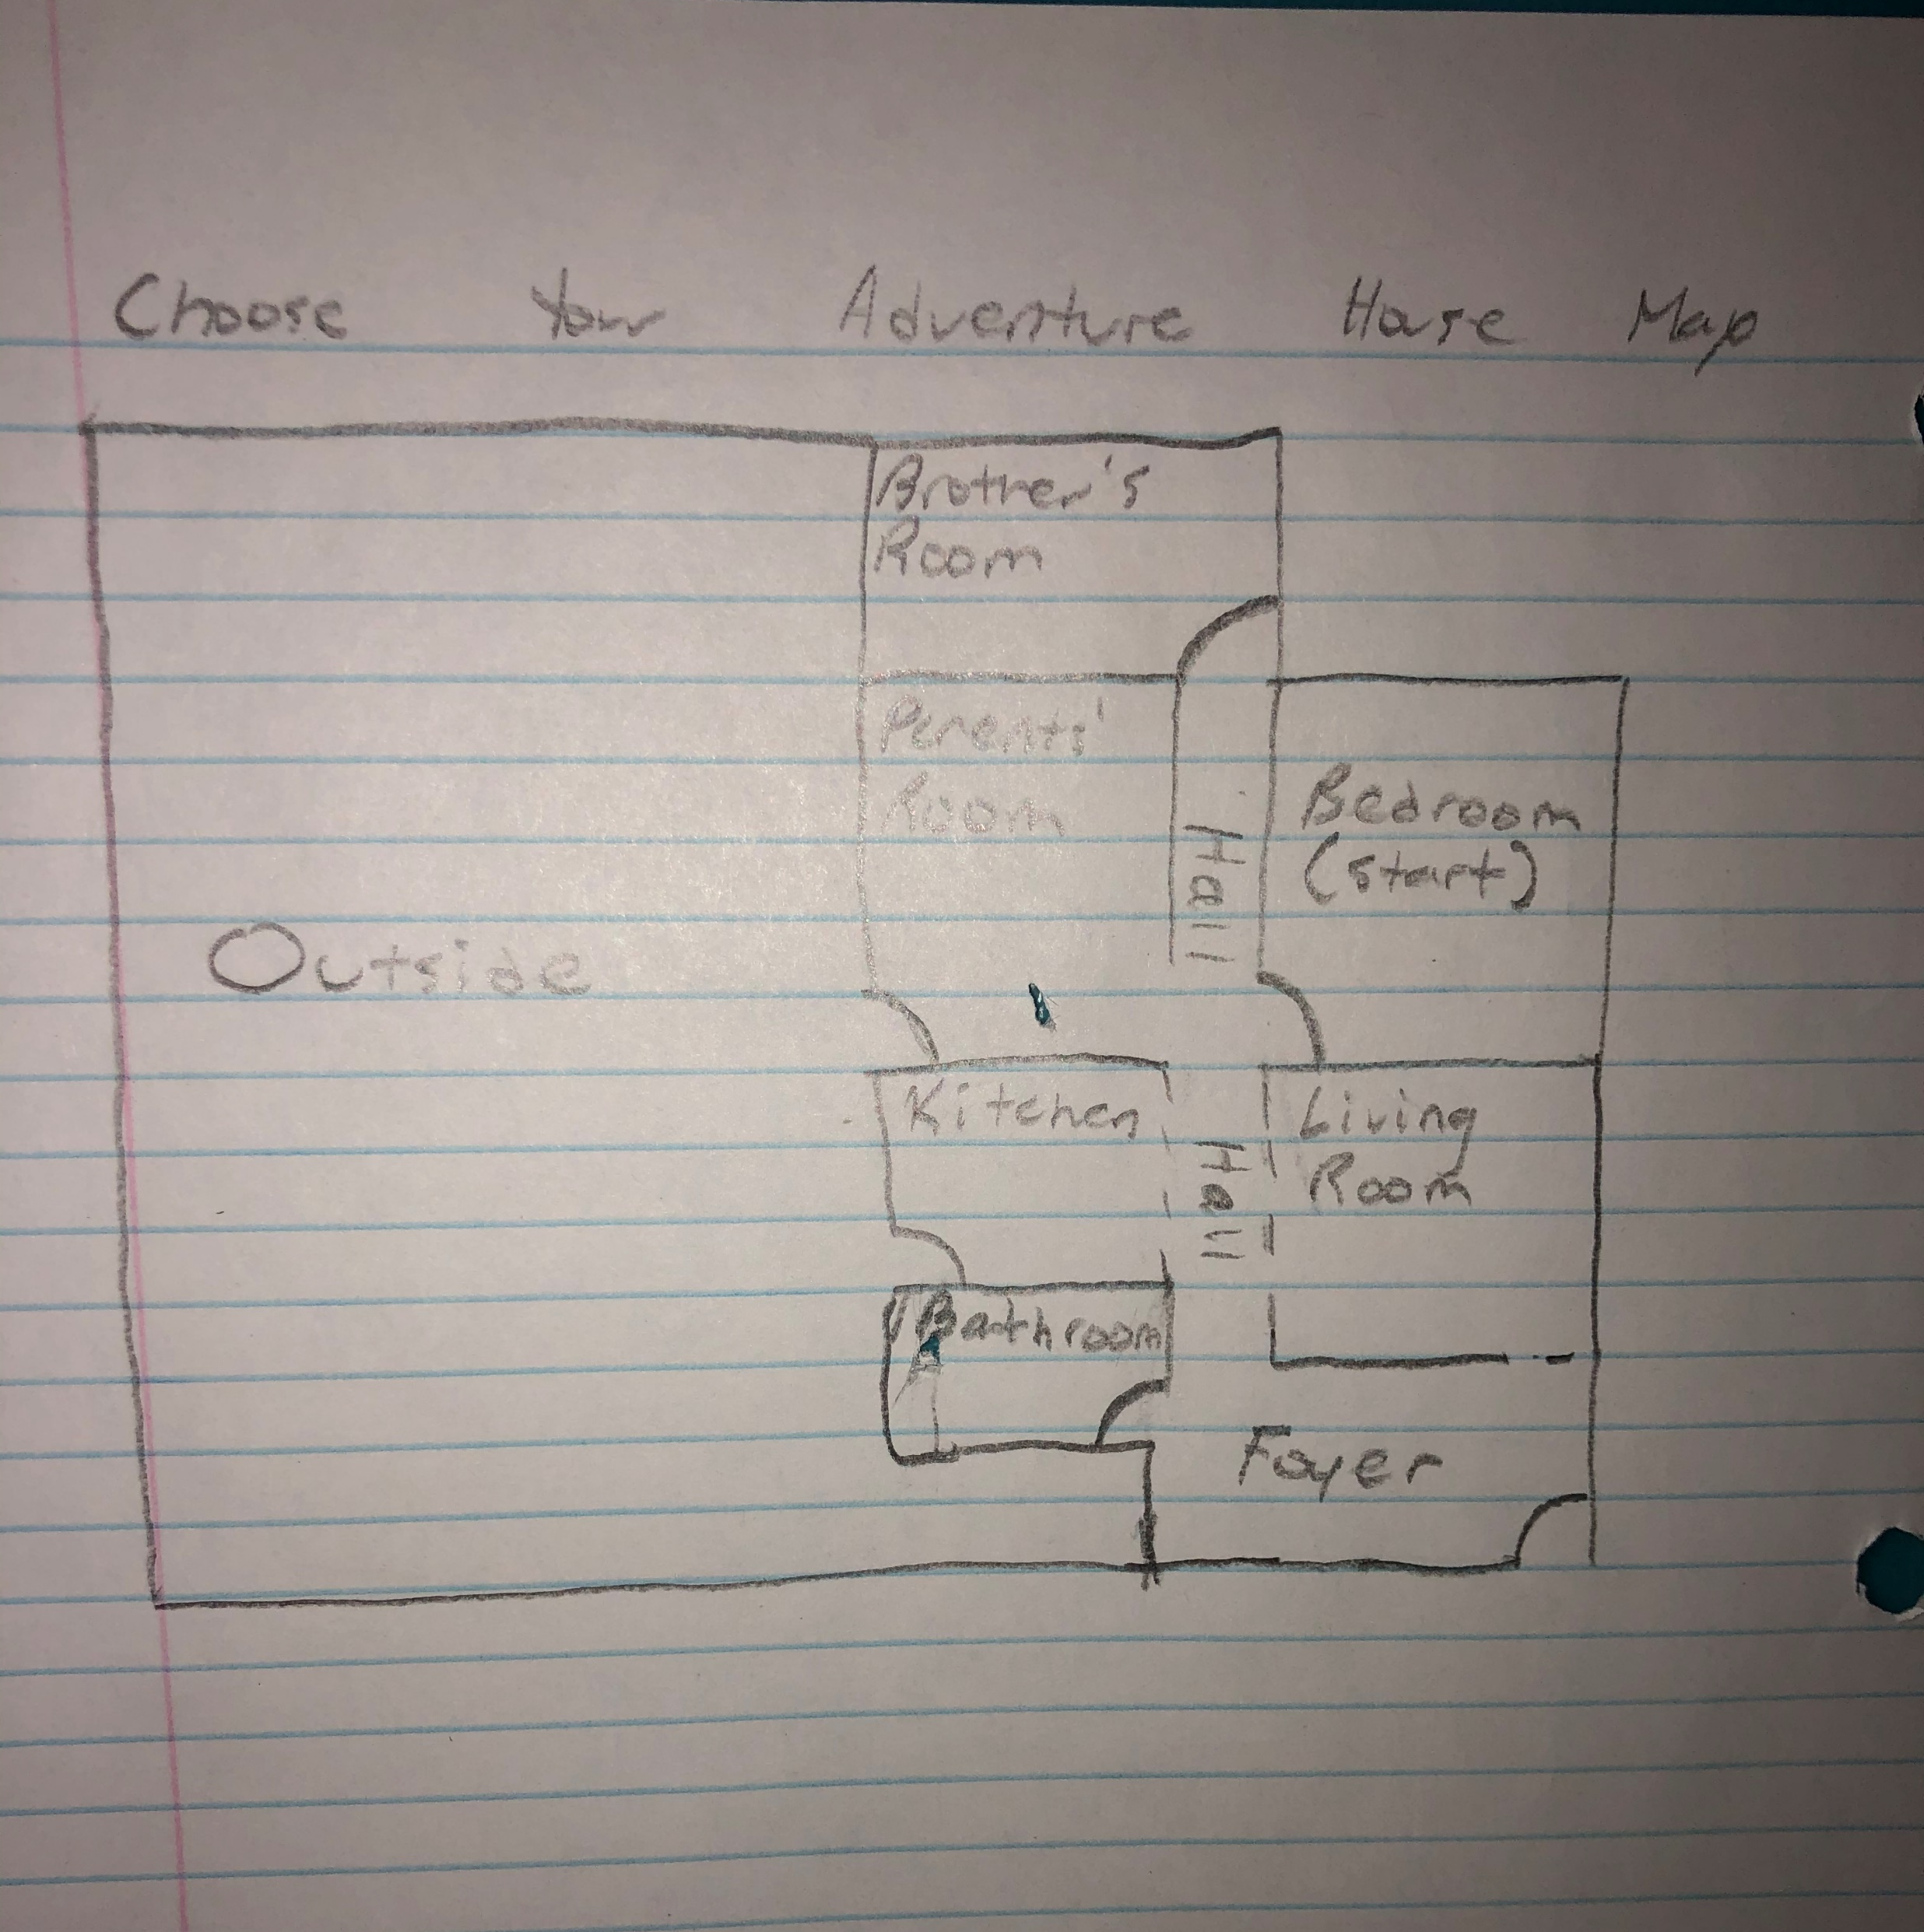
How to Play
Use the map provided to navigate your home.

Slide 7
How to Play
While looking for your family members, you must act quickly. You only get five attempts to locate all 3 of your family members; however, if you revisit a room that has already been searched, it will not count as a guess.
The decisions you make must be made swiftly. There are zombies heading towards your house and you have no time to waste. At the beginning of the game, they are 50m away from the house, but each guess you make, they move 10m closer. Your goal is to find all of your family members before the zombies reach your house.

